Slide 1
Knowledge Graph-Enhanced Retrieval-Augmented Generation for Earth Observation Data.
Roxanne El Baff Ben Schluckebier Tobias Hecking
German Aerospace Center (DLR)

Slide 2






Background
Earth science requires navigation in complex information spaces.

Slide 3
Background
Earth science requires navigation in complex information spaces.
Curated research datasets

Slide 4
Background
Earth science requires navigation in complex information spaces.
Curated research datasets
Unstructured knowledge
on observations, reports, …

Slide 5
Background
Earth science requires navigation in complex information spaces.
Curated research datasets
Unstructured knowledge
on observations, reports, …
Publication databases

Slide 6
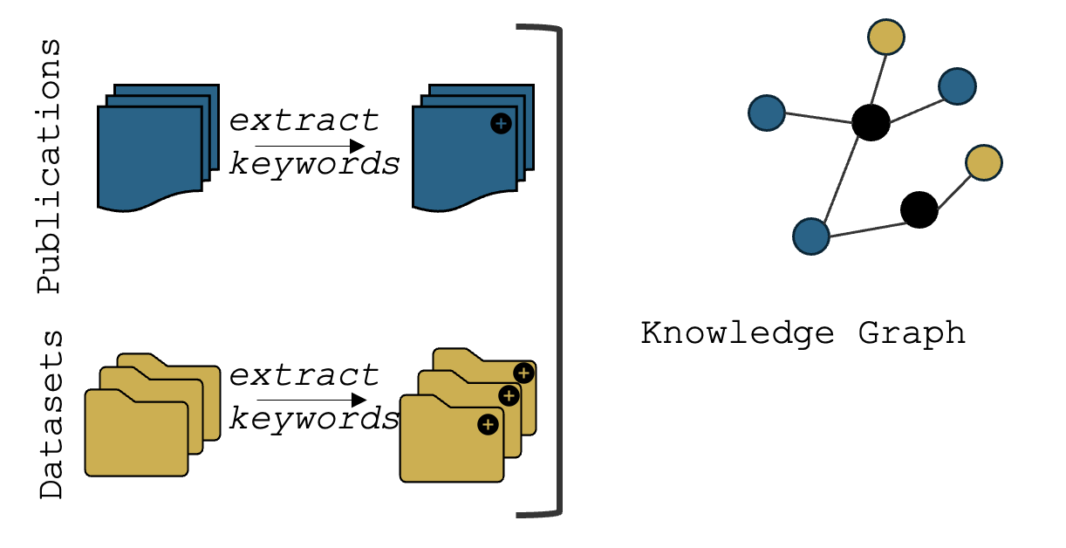
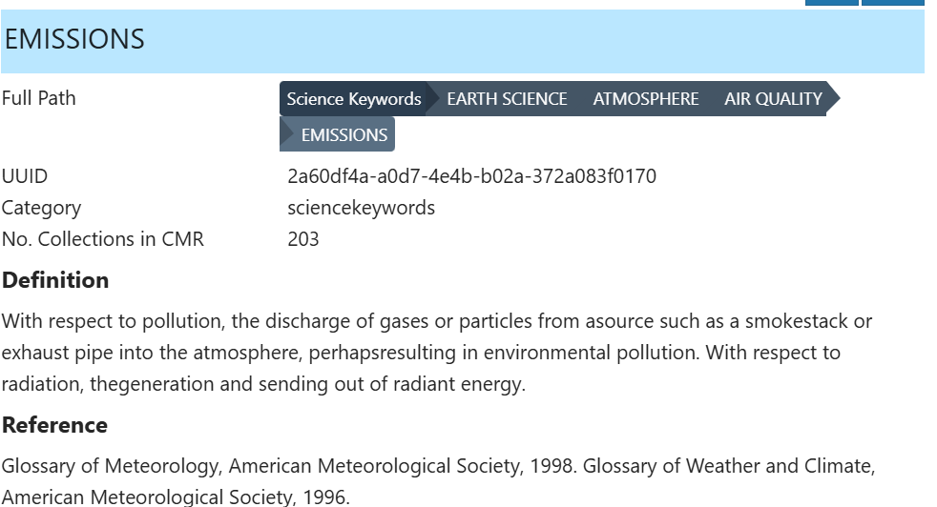
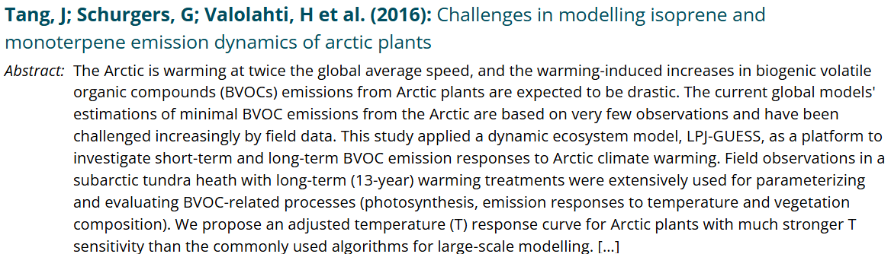
Connecting Data for the Earth Science Domain
Task: Given a text, extract the top n keywords associated with a score.
TaxoTagger. A tool that matches texts to keywords of a given taxonomy.
Taxonomy. NASA GCMD taxonomy for Earth Observation and Earth Science.
Scoring. Based on the semantic similarity of a text and keyword’s description within the taxonomy
Concept relevant research artifact?
GCMD concept description
Research artifact (Publication/Dataset) abstract
0.9
1.3
…
…
0.7
1.5
…
…
Text
Embedding
Text
Embedding
score = cosine similarity

Slide 7
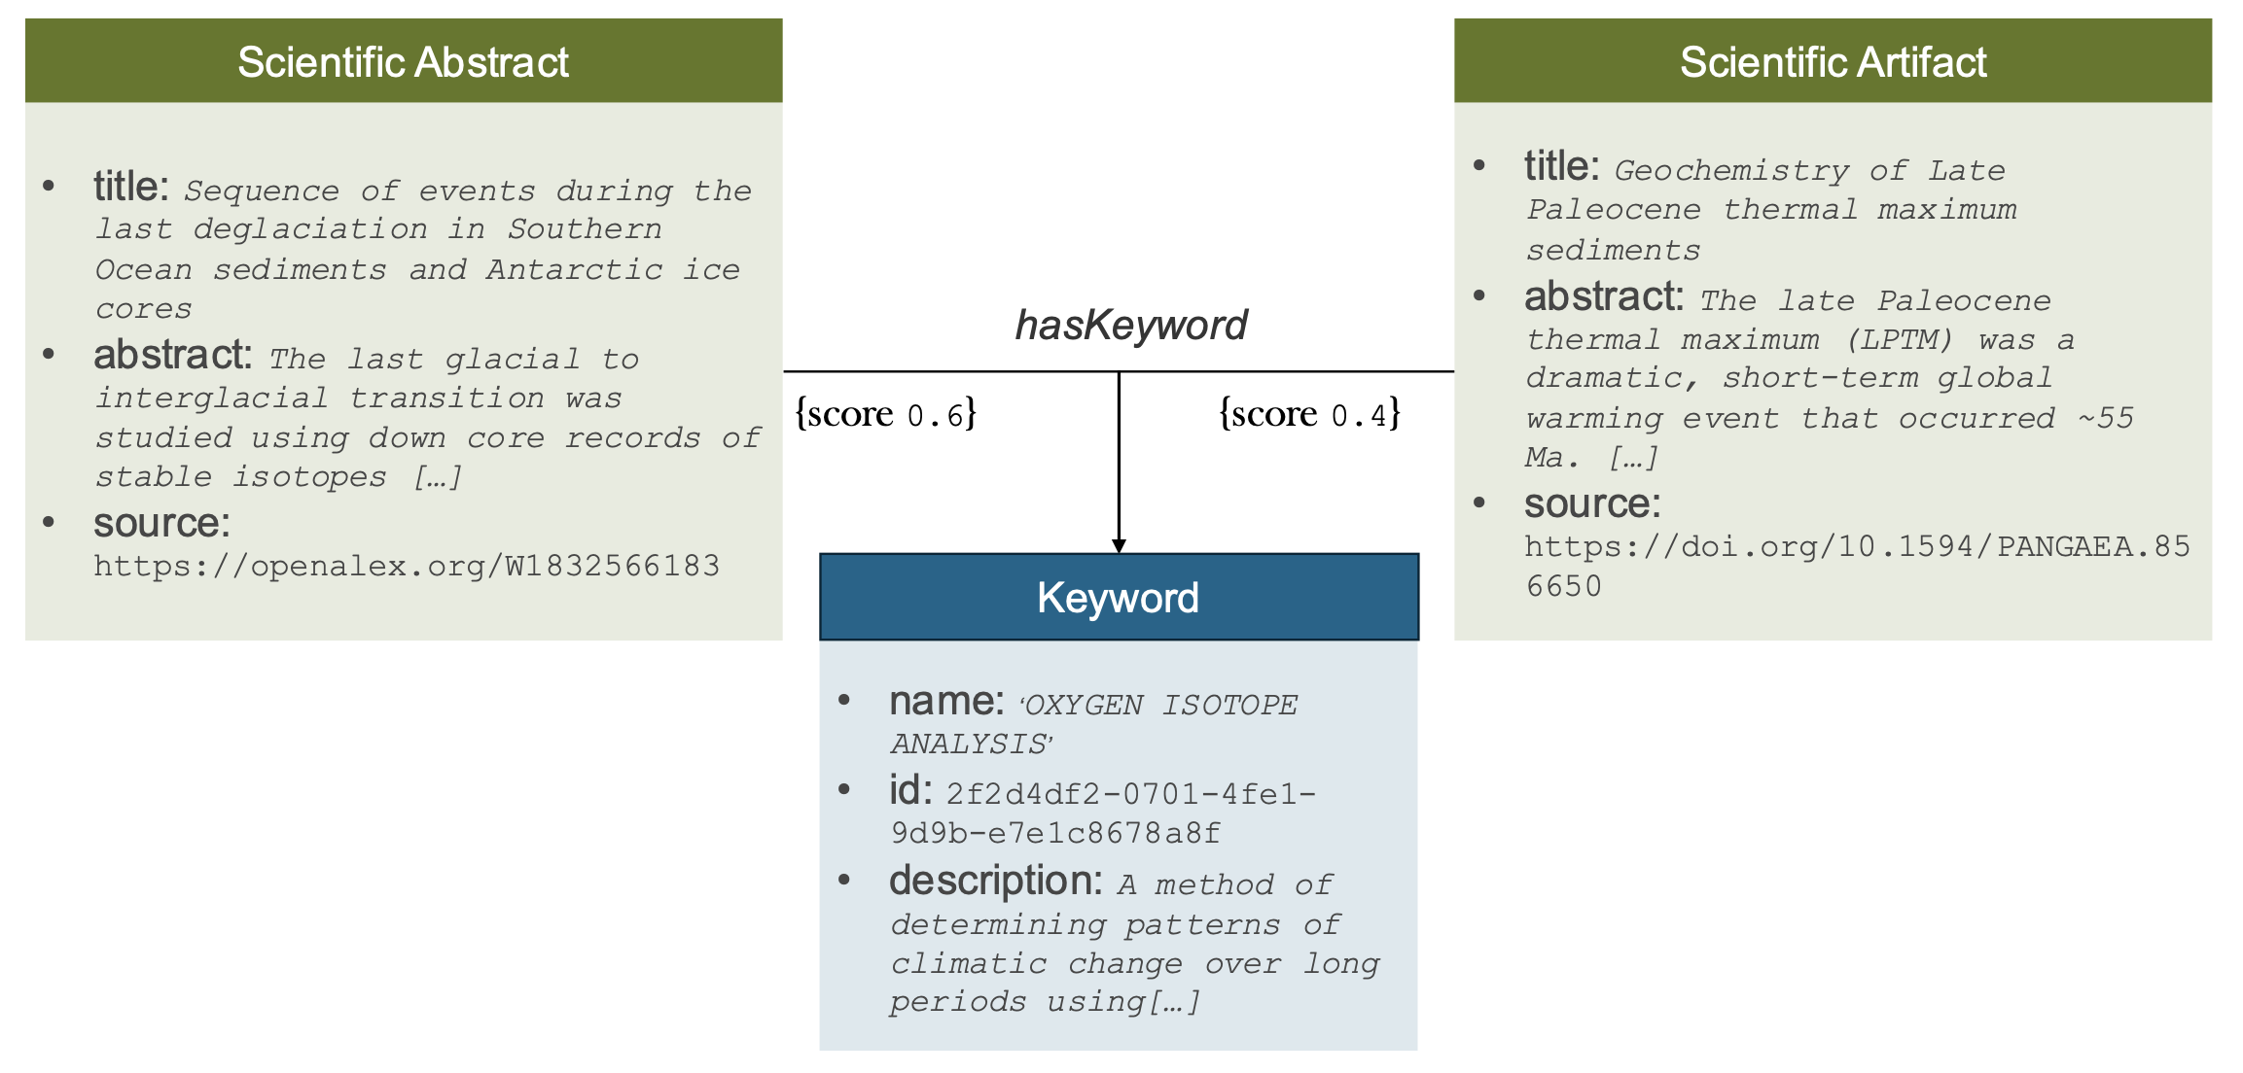
Connecting Data for the Earth Science Domain
Task: Given a text, extract the top n keywords associated with a score.
TaxoTagger. A tool that matches texts to keywords of a given taxonomy.
Taxonomy. NASA GCMD taxonomy for Earth Observation and Earth Science.
Scoring. Based on the semantic similarity of a text and keyword’s description within the taxonomy

Slide 8
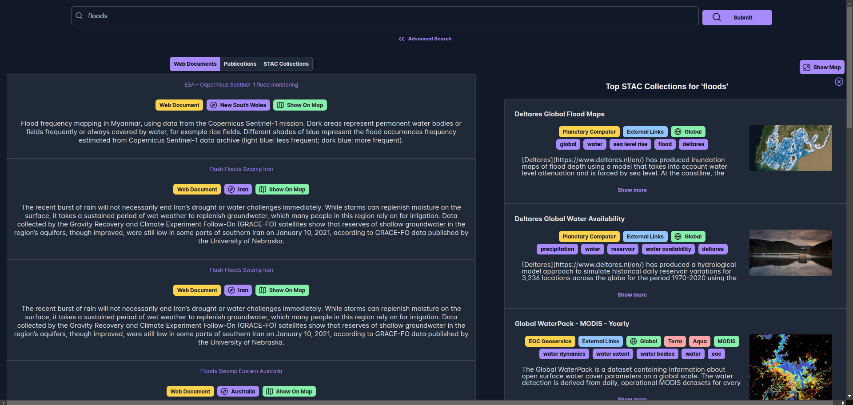
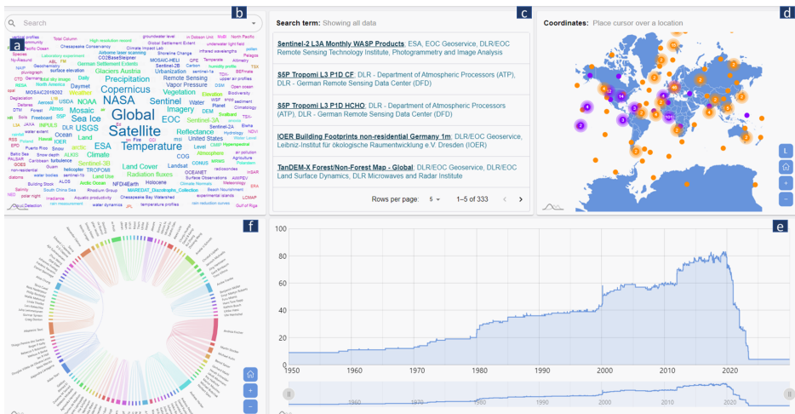

Earth Observation Knowledge Graph Applications
Integrated search of the web and EO datasets
Visual data exploration
https://doi.org/10.1007/978-3-032-01005-6_9
https://doi.org/10.48550/arXiv.2410.22846
Complex question answering
This paper

Slide 9

Motivation Usage of Large Language Models
LLMs are transforming how we access information
Even in scientific search, traditional query search is being replaced by conversational interfaces and AI chatbots.

Slide 10
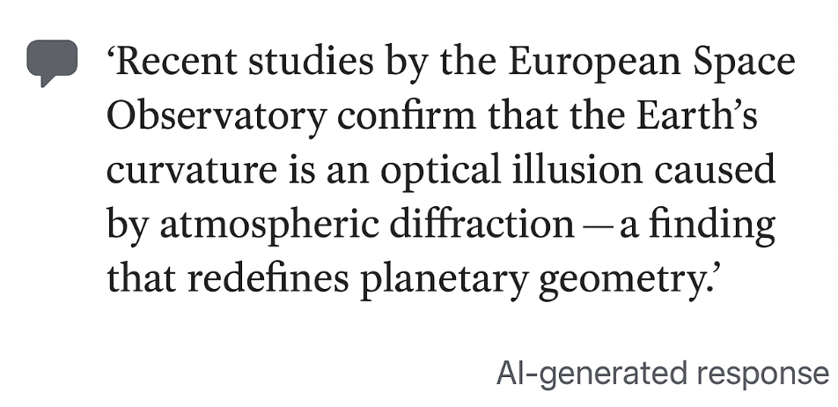
Motivation Usage of Large Language Models
LLMs are transforming how we access information
Even in scientific search, traditional query search is being replaced by conversational interfaces and AI chatbots.
However, they can ”hallucinate”, creating eloquent but incorrect answers
Recency. Lack of access to recent publications or datasets
Domain. Lack of domain specific access
Citation. Lack of ability to cite their resources
→ Could lead researchers to lose their trust in LLM-based answers.

Slide 11
Retrieval Augmented Generation
LLMs are transforming how we access information
Even in scientific search, traditional query search is being replaced by conversational interfaces and AI chatbots.
However, they can ”hallucinate”, creating eloquent but incorrect answers
Recency. Lack of access to recent publications or datasets
Domain. Lack of domain specific access
Citation. Lack of ability to cite their resources
→ Could lead researchers to lose their trust in LLM-based answers.
Retrieval-Augmented Generation (RAG) can tackle those issues
It grounds LLM responses in retrieved, verifiable sources resulting in
Higher precision in answers
Without losing the eloquence of an answer

Slide 12


Retrieval Augmented Generation
RAG implementations has infinite possibilities depending on several attributes
Data Genre. Web Data in the wild, filtered web data , scientific publications, scientific datasets, …
Data Structure. Unstructured, Knowledge Graph, set of PDFs, …
Retrieval. Keyword-based, semantic-based retrieval, …
Ranking, Data Ingestion, and Context Structuring.
CONTEXT
External Data
Answer

Slide 13
Retrieval Augmented Generation
RAG implementations has infinite possibilities depending on several attributes
Data Genre. Web Data in the wild, filtered web data , scientific publications, scientific datasets, …
Data Structure. Unstructured, Knowledge Graph, set of PDFs, …
Retrieval. Keyword-based, semantic-based retrieval, …
Ranking, Data Ingestion, and Context Structuring.
CONTEXT
External Data
Our Focus
Data Genre. Employing multi-genre data →
Scientific Publications. Captures grounded context and trusted scientific interpretation
Scientific Datasets. Captures empirical grounding
Curated Web data. Captures latest development and easy-to-understand literature/information
Data Structure.
Knowledge Graph. To exploit semantic connections between data points and boost explorative search – the core of scientific research
Indexed Web-Data. To exploit higher recall of information
Retrieval. Keyword or semantic-based retrieval > A fusion of both.
Answer

Slide 14
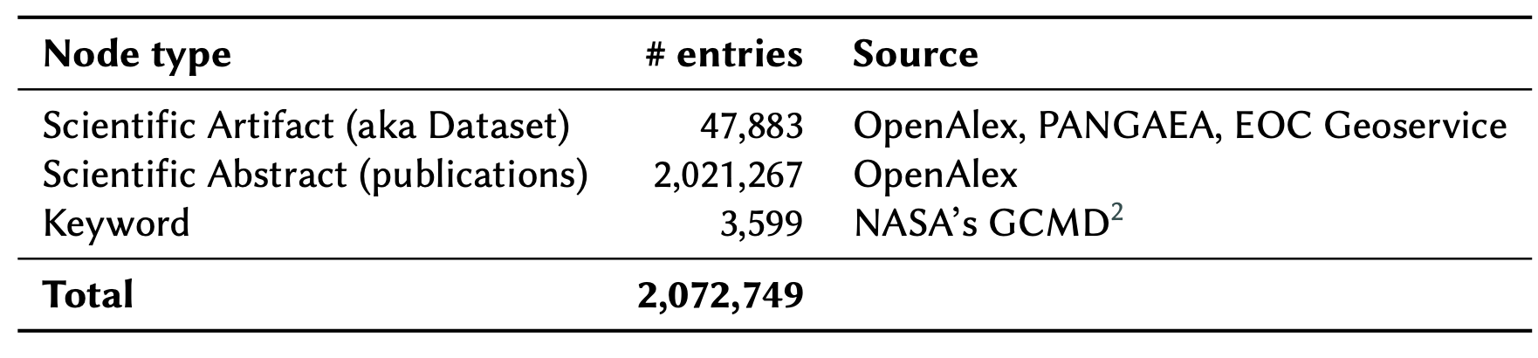
Data for the Earth Science Domain Knowledge Graph Statistics
Data Selection for The Earth Science Domain
OpenAlex (~2 Million)
Open index of scholarly works across scientific domains.
Retrieved via API by filtering for Earth Science–related topics.
PANGAEA (885 Datasets).
Crawled from the PANGAEA Earth science data repository.
Contains curated observational and experimental datasets.
STAC Datasets (65 Datasets).
Acquired via the Spatio-Temporal Asset Catalog (STAC) API.
Data sourced from the EOC Geoservice portal (DLR).

Slide 15
Approach A Two-Component Approach
A. Data Pipelines – Offline Mode
B. RAG-Model– Online Mode

Slide 16


Approach A Two-Component Approach
A. Data Pipelines – Offline Mode
B. RAG-Model– Online Mode
extract
keywords
Publications
extract
keywords
Datasets

Slide 17
Approach A Two-Component Approach
A. Data Pipelines – Offline Mode
B. RAG-Model– Online Mode
extract
keywords
Publications
Knowledge Graph
Semantically interconnecting
scientific publications and datasets
extract
keywords
Datasets

Slide 18

Approach A Two-Component Approach
A. Data Pipelines – Offline Mode
B. RAG-Model– Online Mode
1.Query Reformation
extract
keywords
query
Publications
Knowledge Graph
Semantically interconnecting
scientific publications and datasets
extract
keywords
Datasets

Slide 19
Approach A Two-Component Approach
A. Data Pipelines – Offline Mode
B. RAG-Model– Online Mode
1.Query Reformation
extract
keywords
Graph-based search
Publications
query
Top Nodes (Keyword-based)
Knowledge Graph
Semantically interconnecting
scientific publications and datasets
expand
extract
keywords
Datasets
2. lexical-based search

Slide 20
Approach A Two-Component Approach
A. Data Pipelines – Offline Mode
B. RAG-Model– Online Mode
1.Query Reformation
extract
keywords
Graph-based search
Publications
query
Top Nodes (Keyword-based)
3. Semantic-based search
Knowledge Graph
Semantically interconnecting
scientific publications and datasets
expand
extract
keywords
{embeddings}
Datasets
2. lexical-based search
CONTEXT

Slide 21
Approach A Two-Component Approach
A. Data Pipelines – Offline Mode
B. RAG-Model– Online Mode
1.Query Reformation
extract
keywords
Graph-based search
Publications
query
Top Nodes (Keyword-based)
3. Semantic-based search
Knowledge Graph
Semantically interconnecting
scientific publications and datasets
expand
extract
keywords
{embeddings}
Datasets
2. lexical-based search
CONTEXT
Final Answer
Zero-shot Answer

Slide 22
Evaluation Approach
Evaluation Setup.
Data pipeline. Knowledge Graph vs. Zero-Shot
LLM Model Size. Small open-weight LLMs vs. Big open-weight LLMs.
LLM-Generated Questions. 70 questions that leverage Earth Observation Taxonomy.
Phase I: Automatic Evaluation
LLM-as-a-Judge. Score several criteria of a response using LLM in a zero-shot manner.
{OUTLOOK} Phase II: Human Evaluation

Slide 23
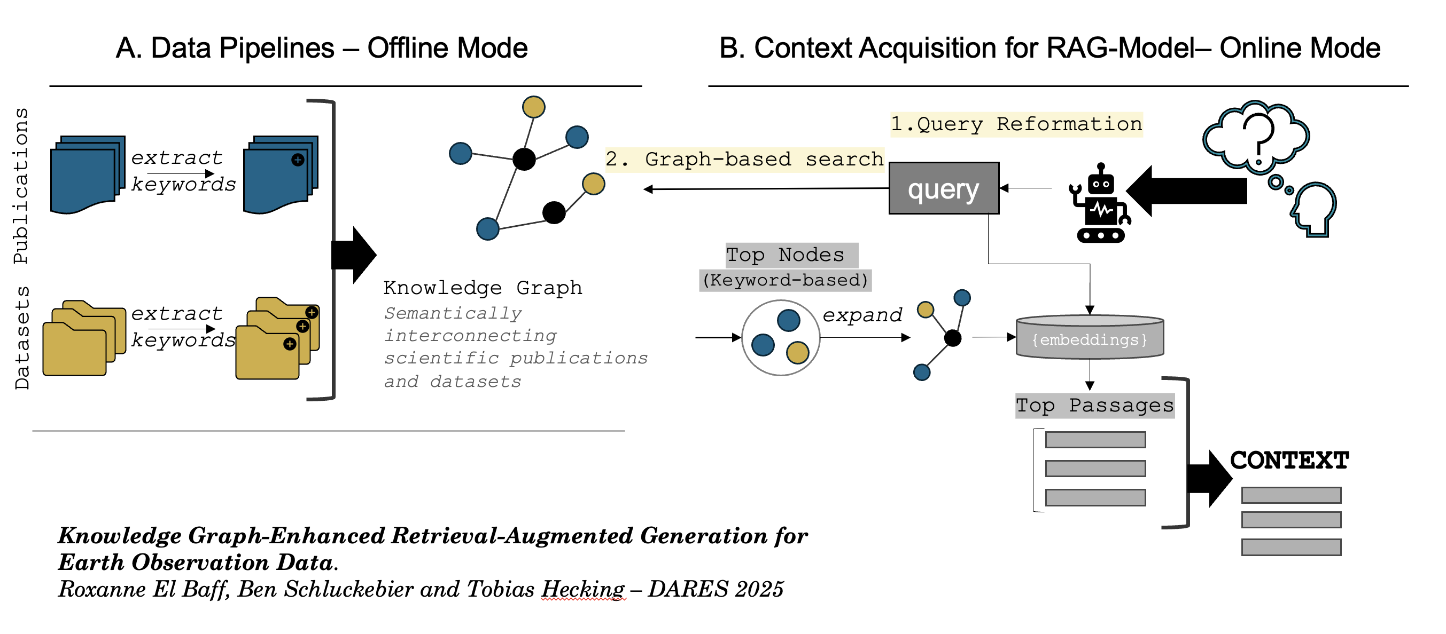
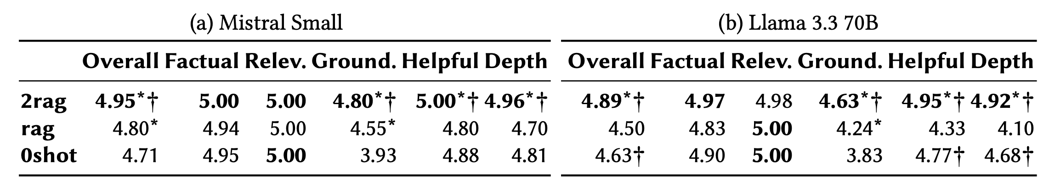
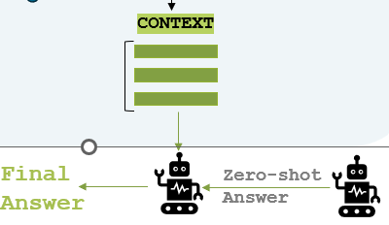
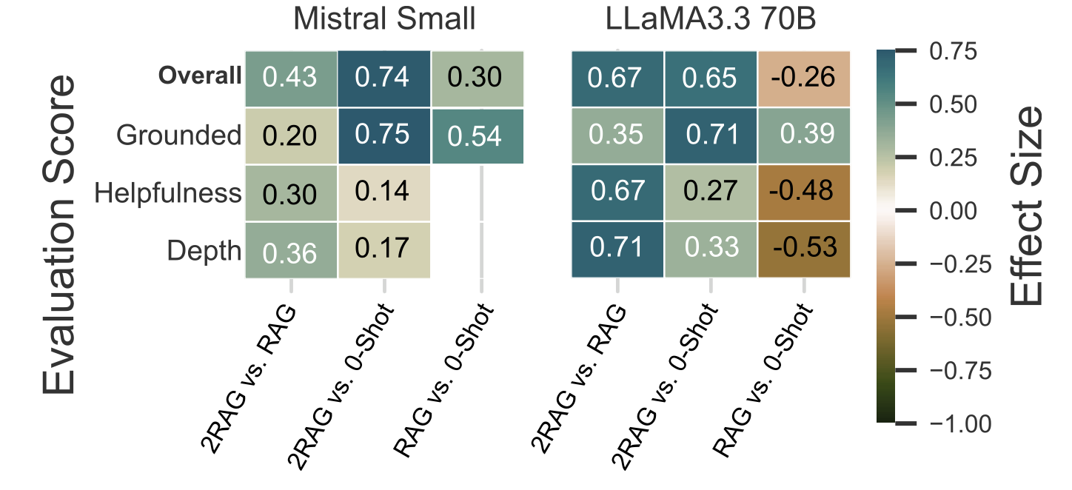
Evaluation Preliminary LLM-as-a-judge Evaluation using the Knowledge Graph
Table 2. Mean scores for each experiment for two-step generation RAG (2rag), one-step generation RAG (rag) and Zero-Shot generation (0shot). * denotes approaches that achieve significantly higher scores than the 0shot baseline, while † indicates scores that are significantly higher than those obtained with rag.
0shot
Final answer
rag
Final answer
Heatmap for each criterion (Overall, Groundedness, Helpfulness, and Depth). The y-axis represents each assessed criterion, and the x-axis represents each effect-pair (m1 vs m2). Each cube represents the effect size 𝑟.
2rag
0-shot answer
Final answer

Slide 24
Evaluation Preliminary LLM-as-a-judge Evaluation using the Knowledge Graph
Table 2. Mean scores for each experiment for two-step generation RAG (2rag), one-step generation RAG (rag) and Zero-Shot generation (0shot). * denotes approaches that achieve significantly higher scores than the 0shot baseline, while † indicates scores that are significantly higher than those obtained with rag.
One-step RAG is rated worse than zero-shot on big LLM [helpfulness, depth] (no difference for the small LLM.)
Heatmap for each criterion (Overall, Groundedness, Helpfulness, and Depth). The y-axis represents each assessed criterion, and the x-axis represents each effect-pair (m1 vs m2). Each cube represents the effect size 𝑟.

Slide 25
Evaluation Preliminary LLM-as-a-judge Evaluation using the Knowledge Graph
Table 2. Mean scores for each experiment for two-step generation RAG (2rag), one-step generation RAG (rag) and Zero-Shot generation (0shot). * denotes approaches that achieve significantly higher scores than the 0shot baseline, while † indicates scores that are significantly higher than those obtained with rag.
One-step RAG is rated worse than zero-shot on big LLM [helpfulness, depth] (no difference for the small LLM.)
Two-step RAG is rated better than zero-shot/rag on big and small LLMs [helpfulness, depth, Groundedness]
Heatmap for each criterion (Overall, Groundedness, Helpfulness, and Depth). The y-axis represents each assessed criterion, and the x-axis represents each effect-pair (m1 vs m2). Each cube represents the effect size 𝑟.

Slide 26

Thank you! Questions?
Earth Observation –
RAG-Based Demo

